Slide 1



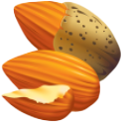
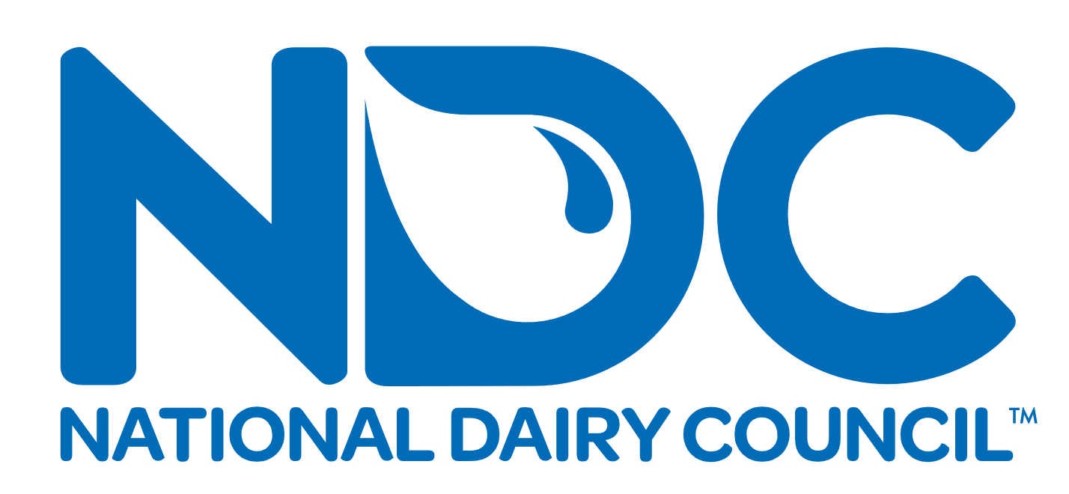
What’s in Your Glass?
Choices are great, but they can be overwhelming.
This at-a-glance chart can help you understand what’s in your glass.
$0.29
per 8 oz.* 
$0.55
per 8 oz.*
$0.53
per 8 oz.*
$0.46
per 8 oz.*
$0.68
per 8 oz.*
$0.22
8 oz. per
gallon*
Dairy Milk, 1%
(8 oz., unsweetened)
Lactose-Free
Dairy Milk, 1%
(8 oz., unsweetened)
Soy Beverage
(8 oz., unsweetened)
Almond Beverage
(8 oz., unsweetened)
Oat Beverage
(8 oz., unsweetened)
106 Calories
8g Protein
2g Fat
13g Carbohydrates
105 Calories
8g Protein
2g Fat
13g Carbohydrates
94 Calories
9g Protein
5g Fat
3g Carbohydrates
37 Calories
1g Protein
3g Fat
1g Carbohydrates
118 Calories
2g Protein
7g Fat
13g Carbohydrates
Cost per 8 ounces based on ½ gallon
sized container
Vitamins and Minerals¹⁻⁴ (% Daily Value)
Vitamin B12
Iodine
Calcium
Riboflavin (B2)
Phosphorus
Pantothenic acid (B5)
Niacin (B3)
Vitamin A
Vitamin D
Potassium⁵
Zinc
Selenium
60%
60%
25%
25%
20%
20%
15%
15%
15%
10%
10%
10%
60%
60%
25%
25%
20%
20%
15%
15%
15%
10%
10%
10%
40%
2%
20%
15%
15%
N/A
4%
15%
8%
10%
6%
8%
35%
N/A
30%
6%
6%
N/A
<2%
10%
10%
2%
4%
N/A
50%
N/A
30%
55%
20%
N/A
<2%
25%
20%
10%
2%
N/A
= Naturally occurring nutrients
N/A
= Nutrition data not available or reported quantitatively
*Source: Circana Group, L.P. Multi-outlets and convenience stores. 52 week-period ending Dec 1, 2024. (Half-gallon dairy milk, unflavored (1%); dairy milk, lactose-free, unflavored (1%); leading almond, soy and oat beverage brands, unflavored; 1-gallon dairy milk, private label, unflavored.)
USDA, Agricultural Research Service. FoodData Central, 2019. https://fdc.nal.usda.gov/. FDC IDs: 746772, 2705389, 1999630, 1999631, 2257046. Accessed December 2024.
USDA, Agricultural Research Service. USDA, FDA and ODS-NIH Database for the Iodine Content of Common Foods Release 3.0 (2023).
Naturally occurring nutrients based on publicly available product ingredient lists. Accessed July 2023. Lactose-free milk is real dairy milk that has added lactase enzymes to break down lactose. USDA FDC ID 2705389 does not include values for iodine, pantothenic acid and tryptophan (for niacin equivalents) as of December 2024.
FDA’s Daily Value (DV) for potassium of 4700 mg is based on a 2005 DRI recommendation. In 2019, NASEM updated the DRI to 3400 mg.
These values are based on the 2019 DRI of 3400 mg.
©2025 National Dairy Council®

